Slide 1
BDM CAPSTONE SALES ANALYSIS AND INVENTORY BREAKDOWN OF A STATIONERY SHOP
MOHIT MAYANK CHAKRABORTY [21f1003057]

Slide 2
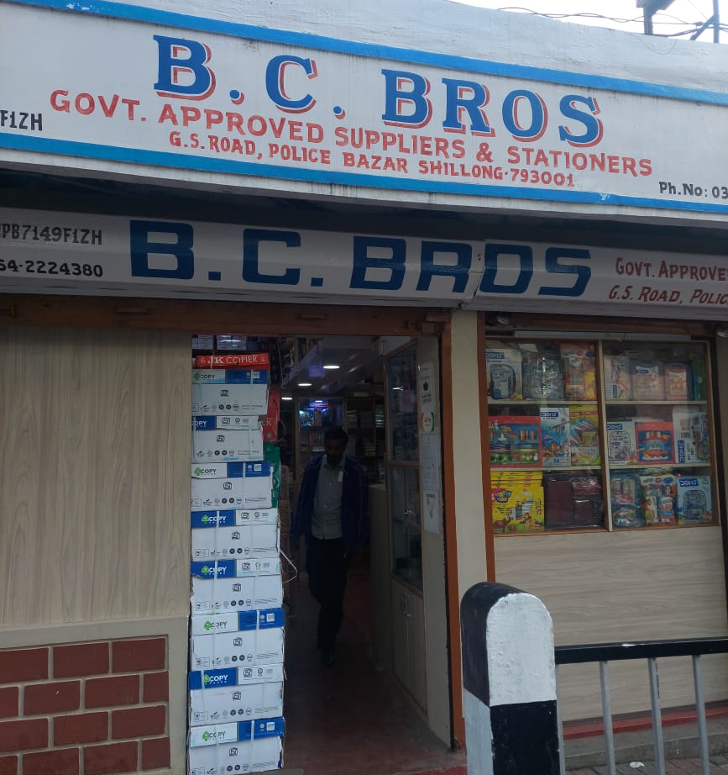
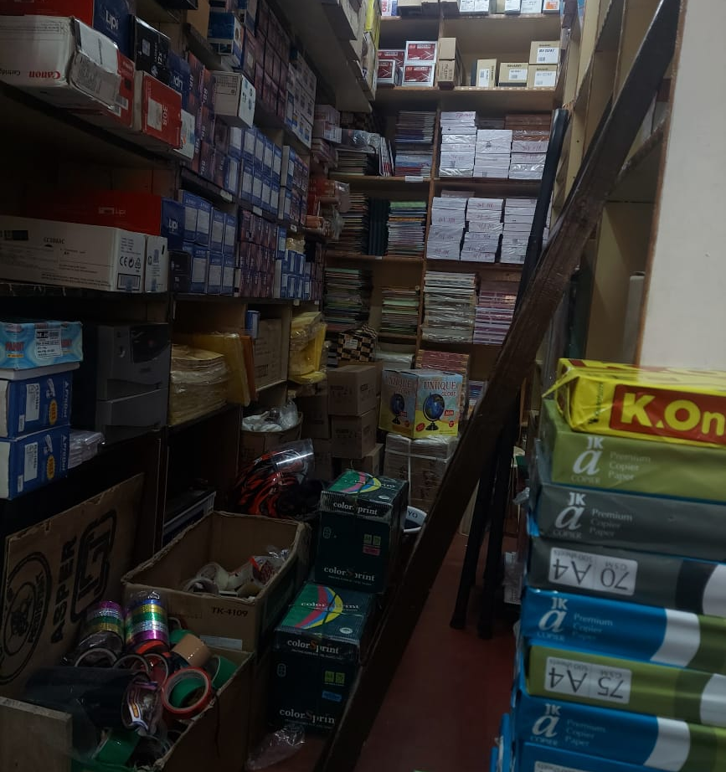
ORGANIZATION BACKGROUND
B.C.Brothers founded in 1952 by Mr. R.P.Bhattercharjee.
Small stationery business – 8 employees.
Wide variety of goods – printer cartridges, paper products, keyboards.
Customers – Students, Office workers, Local Businesses.

Slide 3

PROBLEM STATEMENT
REVENUE TRENDS
B2B V. B2C
PRICE FLUCTUATIONS

Slide 4
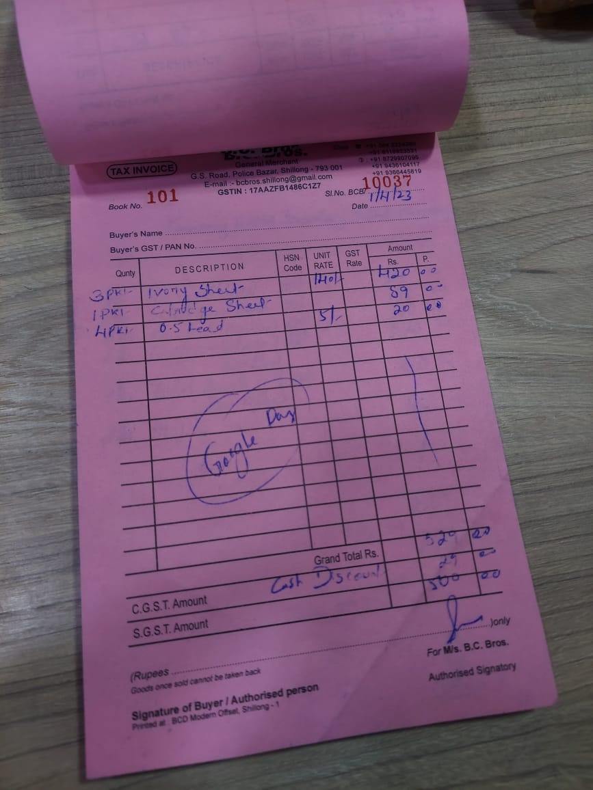
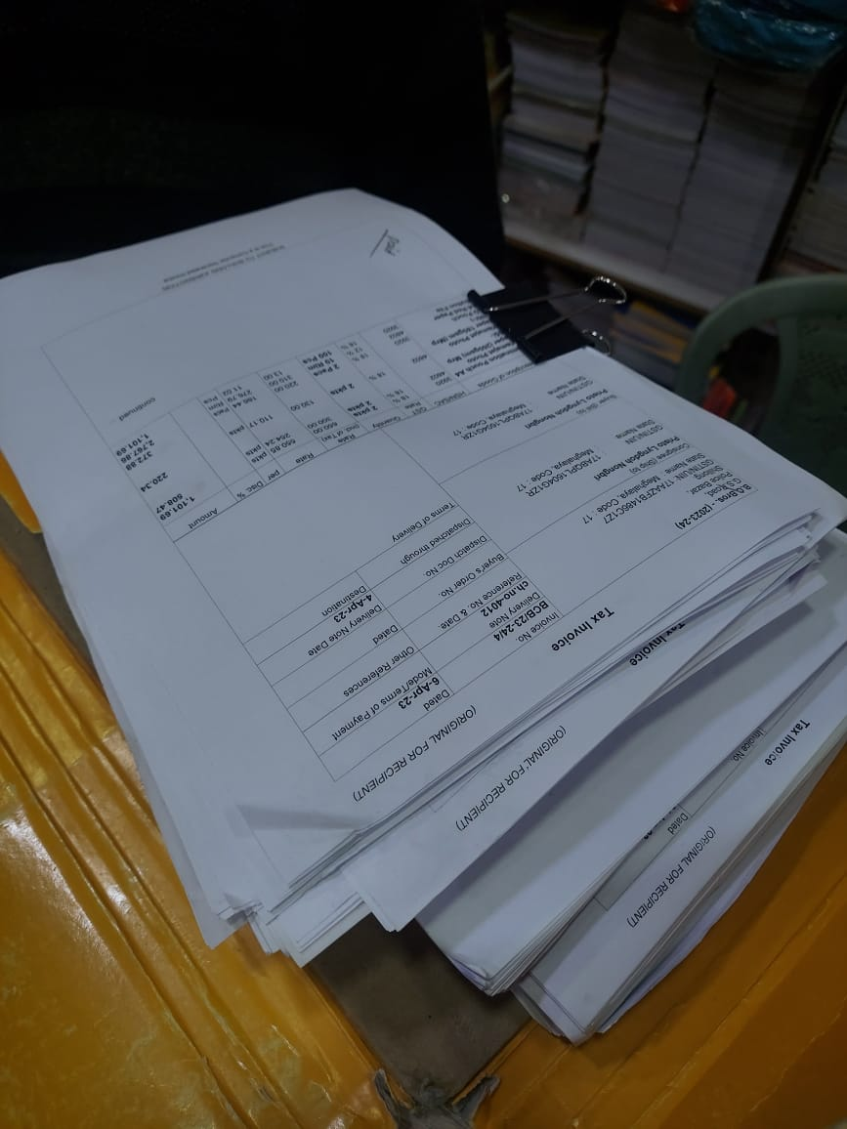
DATA COLLECTION

Slide 5
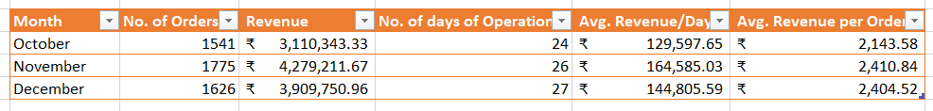
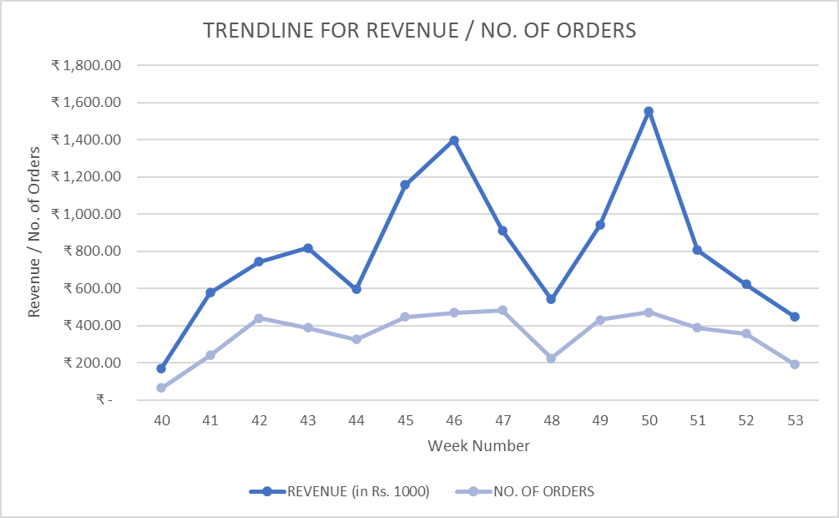
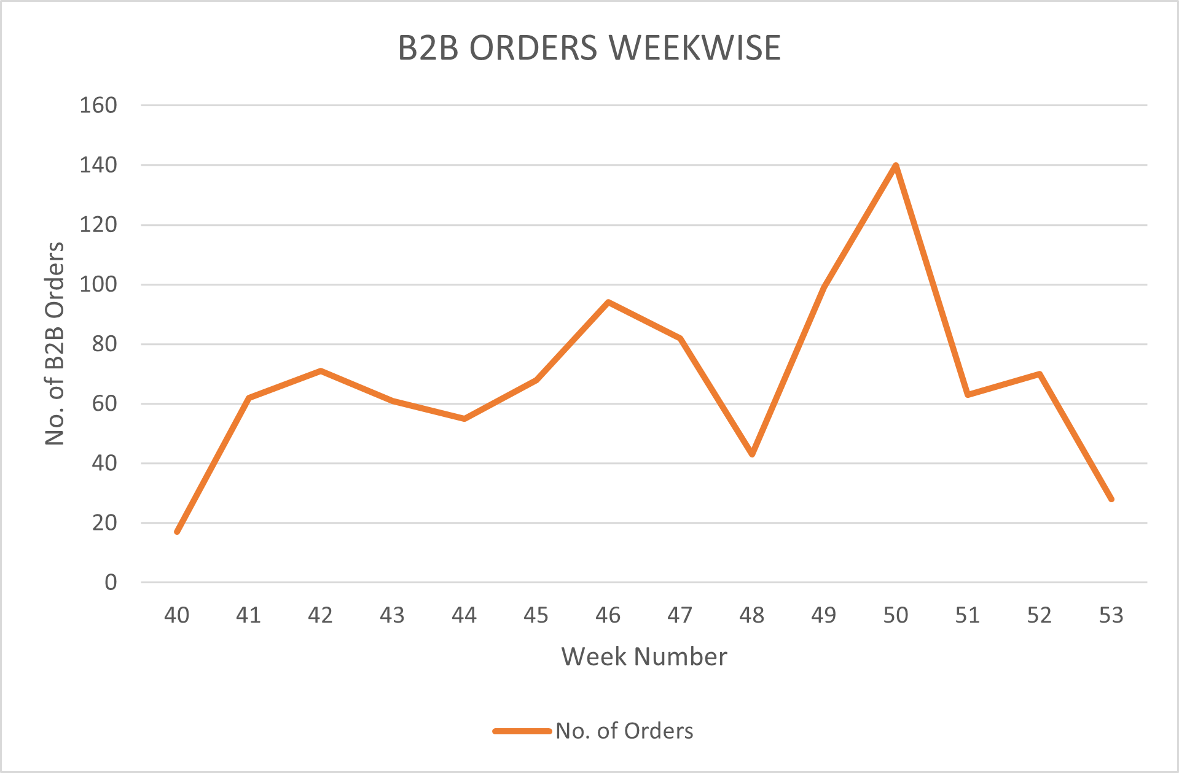
DATA ANALYSIS: REVENUE

Slide 6
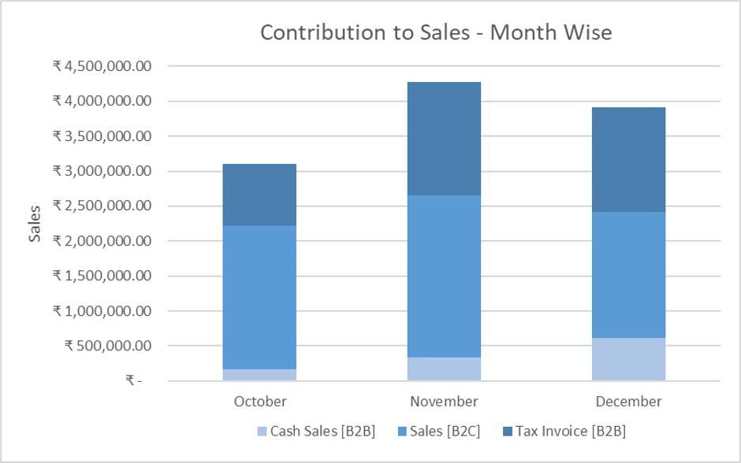
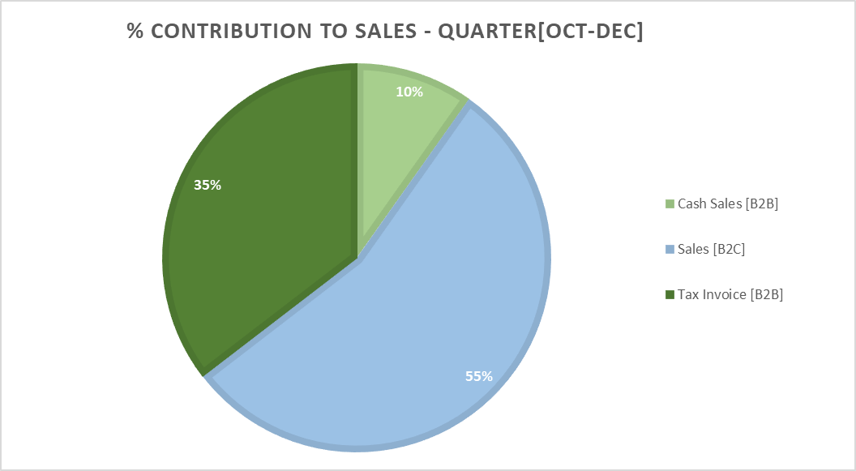
DATA ANALYSIS: B2B V. B2C
Bill amount [B2C]: 1556 +- 2596
LVTs = 25%

Slide 7
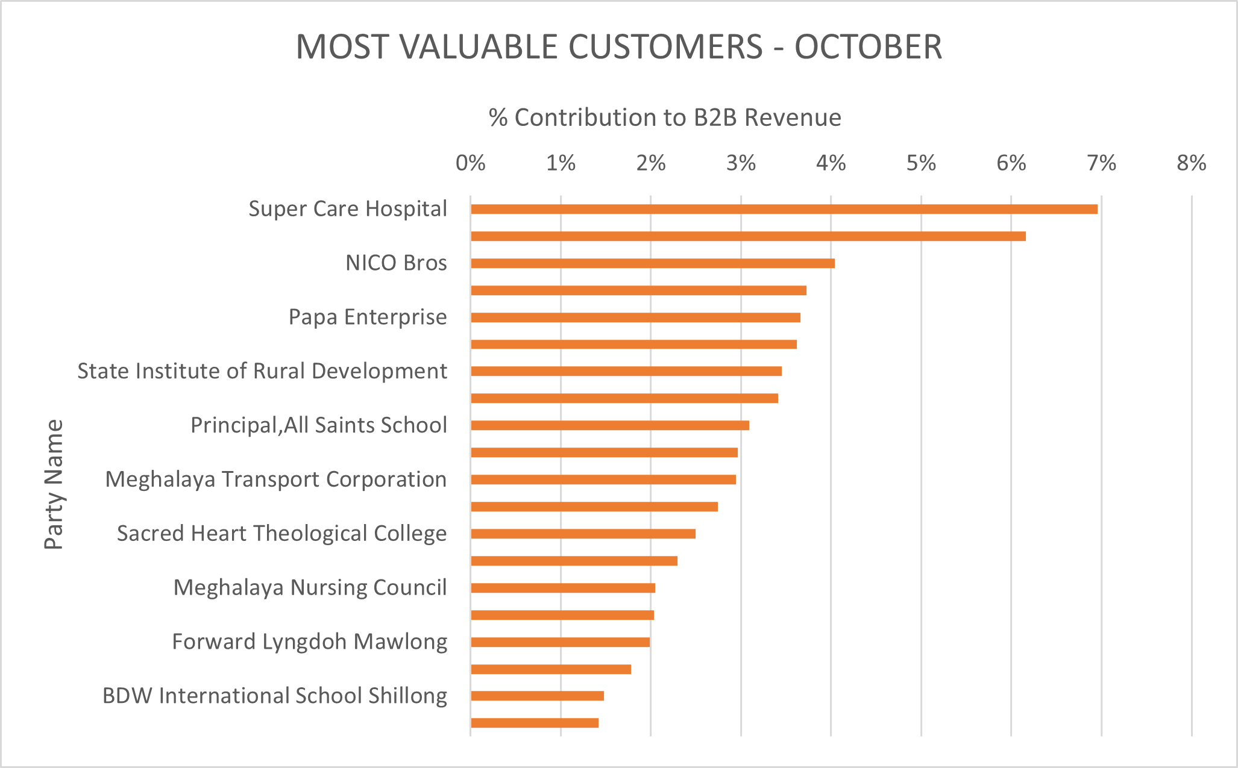
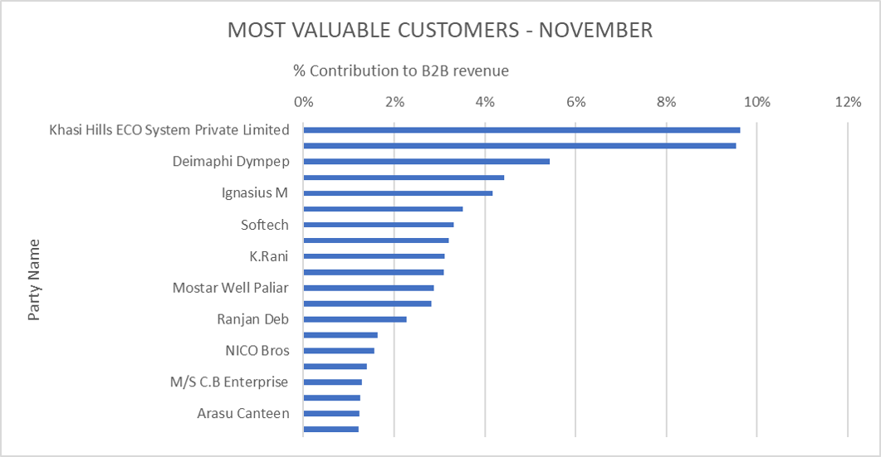
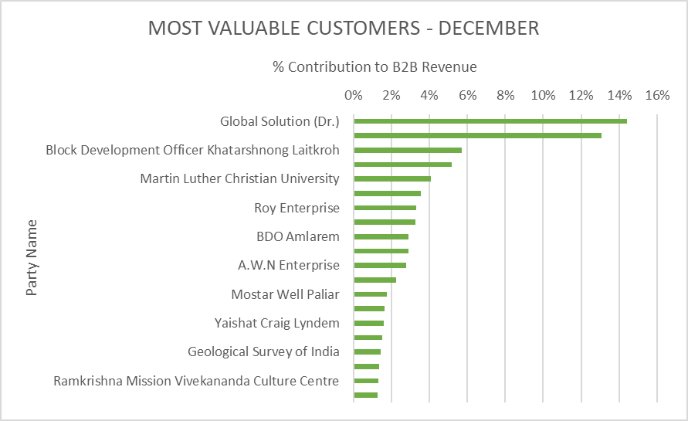
DATA ANALYSIS: B2B V. B2C
238 unique enterprises: 161 low value
48 most valuable customers
Contributions: 65% [Oct], 67% [Nov], 75% [Dec]

Slide 8
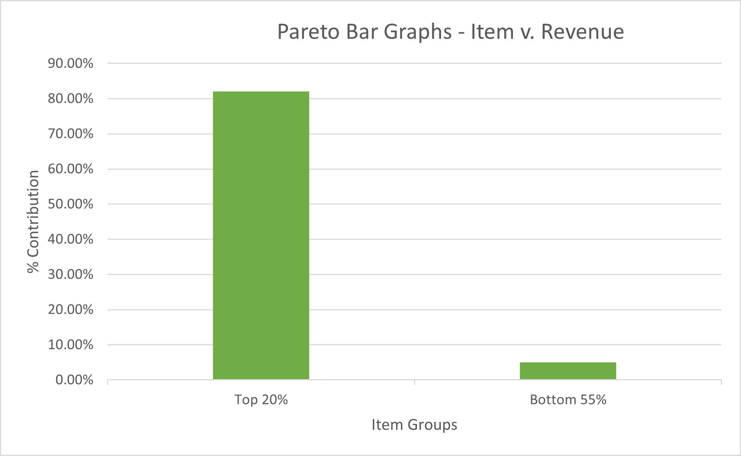
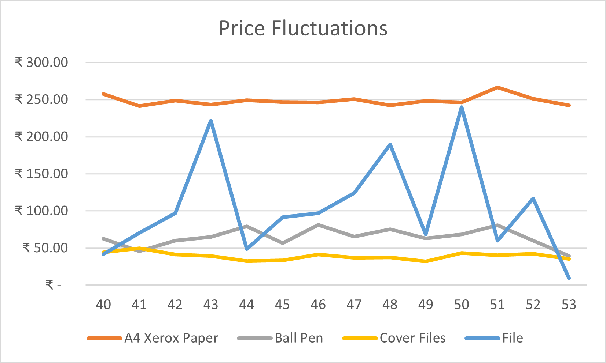
DATA ANALYSIS: ITEM ANALYSIS
945 unique items; 170 items contribute significantly to revenue.
Reasons:
Changes in cost price.
Lack of Brand/Item Info.
Lack of Unit info.

Slide 9



RECOMMENDATIONS
Computerize Records
Store the SKU or UPC number for each item sold.
Implement bar code scanners at the point of sale.
Inventory pruning
Reduce the number of goods in the inventory.
Procure high demand items well in advance.
Form sale contracts with valuable customers.
Customer Relations
Train employees to create and maintain relations with customers.

Slide 10
Thank You

